Slide 1
Music Box Churn User Prediction
Presenter: Lang Yujian

Slide 2
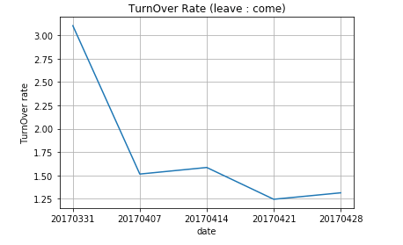
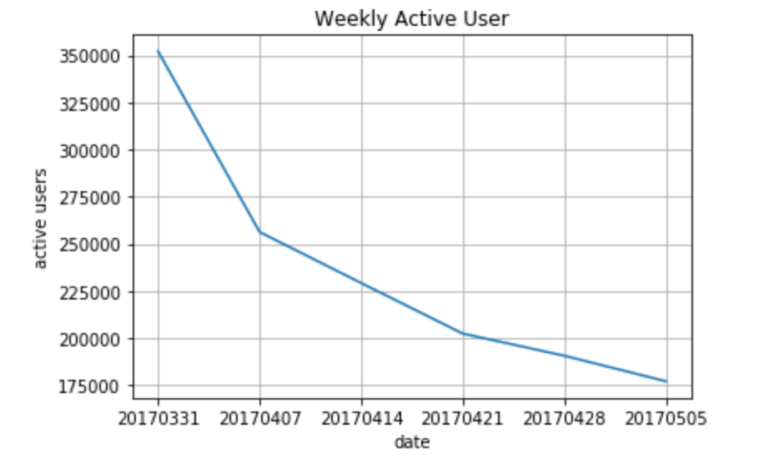
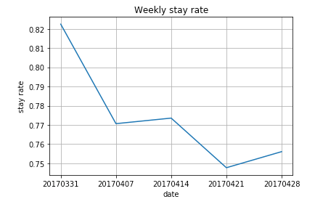
Understand Data

Slide 3
Steps
Combine and load all user activity records.
Selected users for training and test purpose with/without sliding window snapshot
Define churn label (active before and no activity in following 14 days)
Identify churn users and non churn users
Resample two classes => user set => activity records dataset
Generate features for model construction
Velocity: activity type + period length combination, e.g. play_7
Acceleration: ratio of different time window, ratio of different type within time window, e.g. play_1_7, play_search_1
User Profile: type of device used, e.g. android
Train model, understand models and compare performances

Slide 4
Results
Top 5 features
 | No Sliding No Acceleration | No Sliding Acceleration | Sliding No Acceleration | Sliding Acceleration
Logistic Regression | ‘ar’ ‘ip’ ‘search_1’ ‘play_1’ ‘search_14’ | ‘ar’ ‘search_down_ratio_1’ ‘search_down_ratio_7’ 'ip’ 'search_1' | ‘ar’ ‘ip’ ‘search_1’ ‘play_1’ ‘search_7’ | ‘ar’ ‘ip’ ‘search_down_ratio_1’ ‘search_ratio_7_1’ ‘search_1’
Random Forest | ‘play_7’ ‘play_14’ ‘search_14’ ‘play_1’ ‘search_7' | ‘play_search_ratio_7’ ‘play_7' ‘play_down_ratio_7' ‘play_ratio_14_7' ‘play_ratio_7_1' | ‘play_1’ ‘play_7’ ‘play_14’ ‘search_7’ ‘search_14’ | ‘play_down_ratio_1’ ‘play_search_ratio_1’ ‘play_1’ ‘play_ratio_7_1’ ‘play_7’
Gradient Boosting Tree | ‘play_7’ ‘play_14’ ‘search_14’ ‘down_14’ ‘play_1’ | ‘play_search_ratio_7’ ‘play_down_ratio_7’ ‘play_7’ ‘play_down_ratio_14’ ‘play_ratio_14_7’ | ‘play_14’ ‘play_7’ ‘play_1’ ‘down_14’ ‘search_14’ | ‘play_search_ratio_14’ ‘play_ratio_14_1’ ‘play_ratio_14_7’ ‘play_down_ratio_14’ ‘play_search_ratio_1’

Slide 5
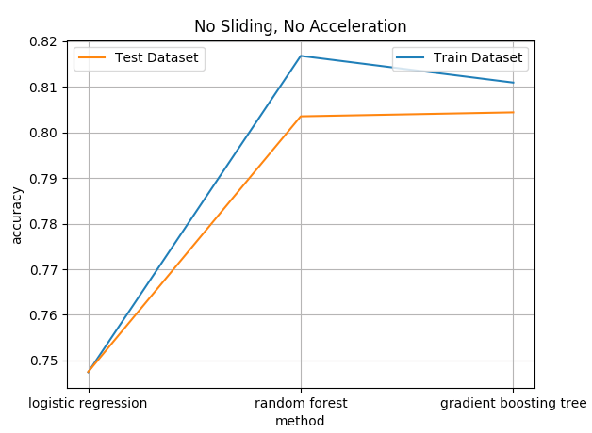
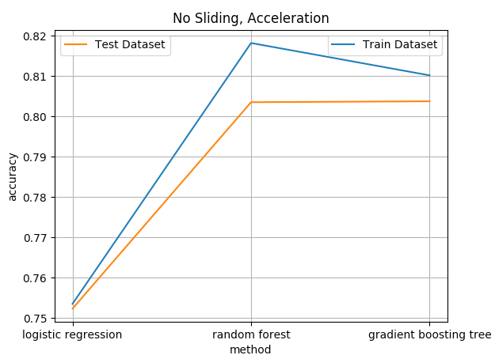
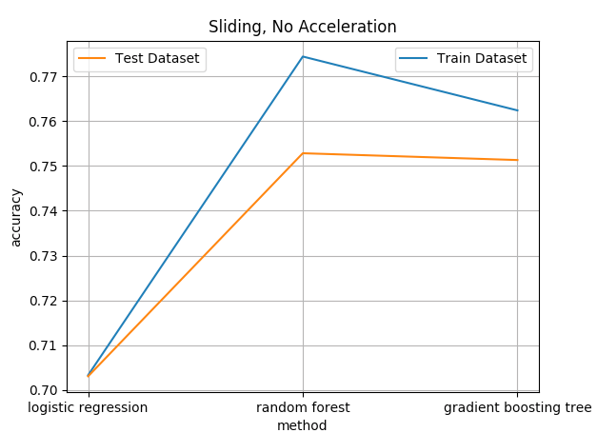
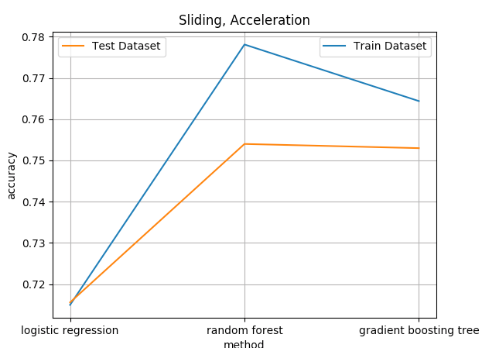
Results
Acceleration
Little improvement
Sliding
Generalize results
Robust

Slide 6
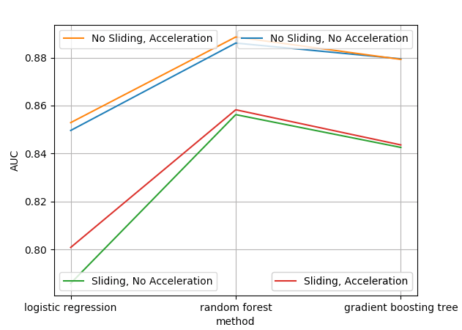
Results
Acceleration
Little improvement
Sliding
Generalize results
Robust

Slide 7
Findings
Adding acceleration features:
Changes little in metrics
Changes feature importance
Generates little new information, but transform previous data
Adding sliding snapshots:
Generates more data
Decreases model performances
Sliding snapshots generalize the data, makes the model to perform more robust
Method selection:
Random Forest ≈ Gradient Boosting Tree > Logistic Regression

Slide 8
Findings
Choose Random Forest:
Top 5 features: ‘play_down_ratio_1’,‘play_search_ratio_1’, ‘play_1’, ‘play_ratio_7_1’, ‘play_7’
low play_down_ratio_1, low play_search_rato_1, play_1
Marketing Campaign

Slide 9
Future Improvements
Create better song profile
Using “collaborative filtering” method to “classify” songs to create better profile
Create better user profile
Using “NLP” to project user profile into vector space
Cluster user profile into k categories
Set up models for each cluster
Engineer more features
Features indicating customer loyalty, e.g. count of songs with play time duration percentage higher than threshold (e.g. 0.5)

Slide 10
Thank you for listening
Q&A

